Slide 1

: Heart Disease Risk Prediction Insights from Healthcare Data
To identify key predictors of heart disease using logistic regression.
Understanding these predictors helps in early diagnosis and intervention.

Slide 2
Dataset Overview
age: The age of the patient.
sex: Gender of the patient (1 = male, 0 = female).
chest pain type: Type of chest pain experienced by the patient (categorical variable with various types).
resting bp: Resting blood pressure in mm Hg.
cholesterol: Serum cholesterol level in mg/dl.
fasting blood sugar: Fasting blood sugar level (1 = greater than 120 mg/dl, 0 = less than or equal to 120 mg/dl).
resting ecg: Results of the resting electrocardiogram (categorical variable with different outcomes).
max heart rate: Maximum heart rate achieved during exercise.
exercise angina: Exercise-induced angina (1 = yes, 0 = no).
oldpeak: Depression induced by exercise relative to rest (in mm).
ST slope: Slope of the peak exercise ST segment (categorical variable with different slopes).

Slide 3
Data Description Preprocessing Steps
Number of rows and columns (e.g., 1190 rows x 12 columns).
272 rows were identified as duplicates and removed.
Number of Rows After Removing Duplicates: 918

Slide 4
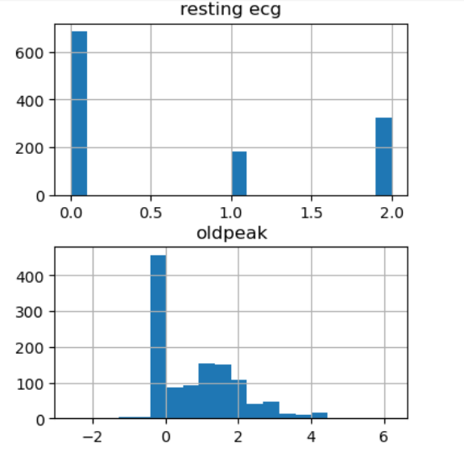
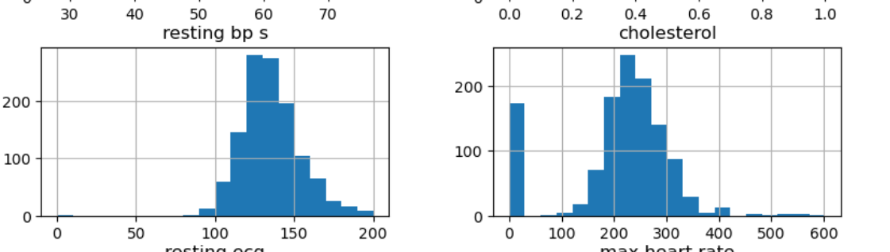
Correlation Matrix Title: Correlation Matrix Analysis
Strong Negative Correlations: Max heart rate and cholesterol are negatively correlated with heart disease risk.
Strong Correlations with Target:
Positive:
Chest Pain Type (0.471)
Exercise Angina (0.494)
Oldpeak (0.404)
ST Slope (0.553)

Slide 5

The primary goal of this analysis was to evaluate and compare the performance of two predictive models—Random Forest and Logistic Regression—in forecasting the likelihood of heart disease. Our aim is to identify the model that provides the most accurate and reliable predictions, which can be critical for improving patient outcomes and guiding clinical decisions. Context
Logistic Regression
Accuracy: 87%
Class 0 (No Heart Disease):
Precision: 87%
Recall: 81%
Class 1 (Heart Disease):
Precision: 86%
Recall: 91%
Summary: The model performs well, accurately predicting heart disease with high precision and recall.

Slide 6

Random Forest Performance
Accuracy: 95%
Class 0 (No Heart Disease):
Precision: 96%
Recall: 92%
Class 1 (Heart Disease):
Precision: 93%
Recall: 97%
Summary: The Random Forest model achieves high accuracy with strong precision and recall, particularly excelling in identifying heart disease cases.

Slide 7
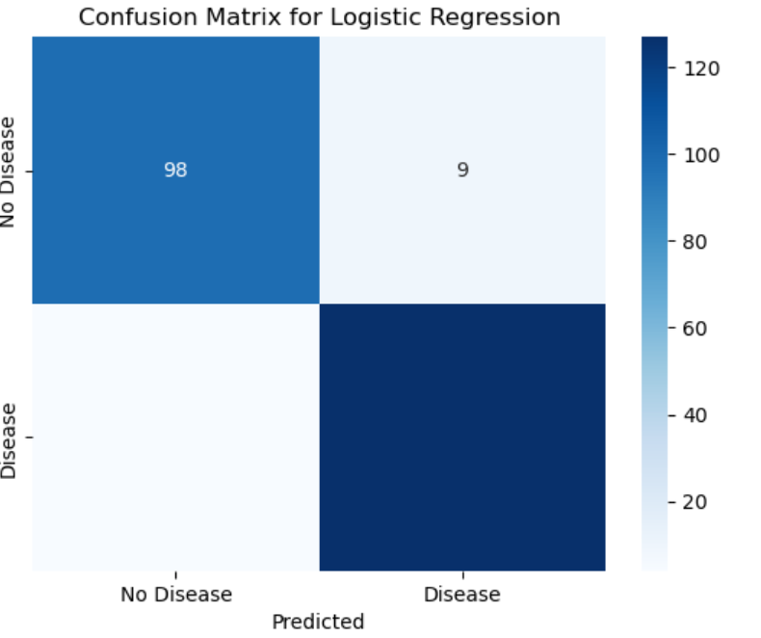
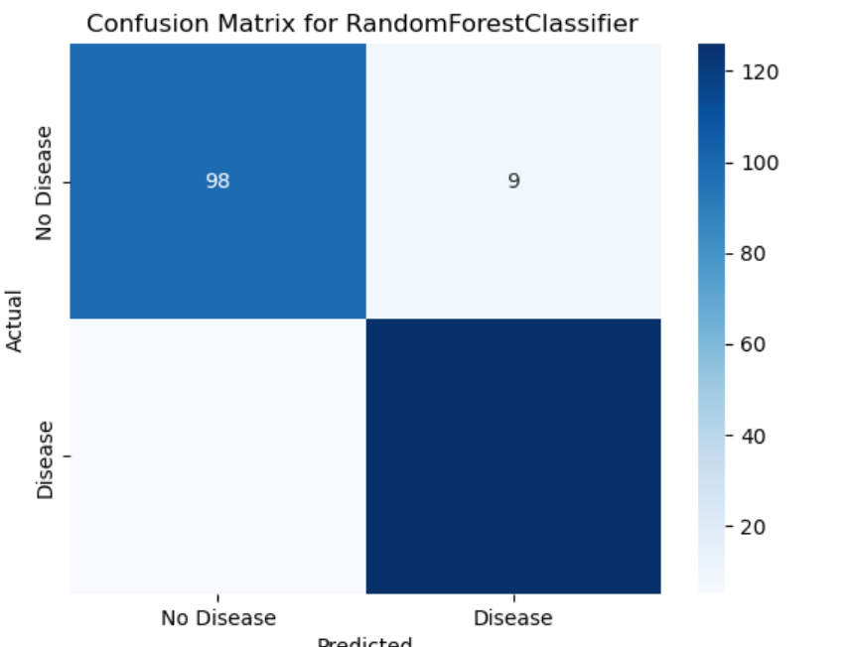
Confusion Matrix Comparison: Logistic Regression vs. Random Forest

Slide 8
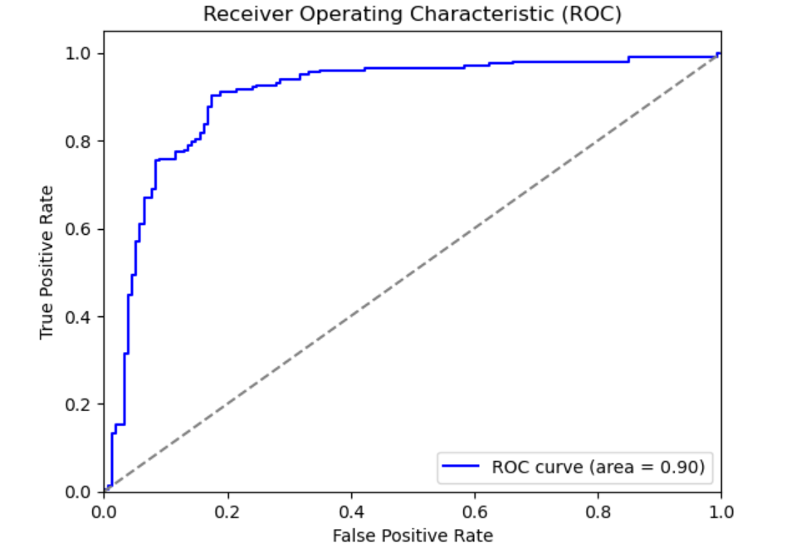
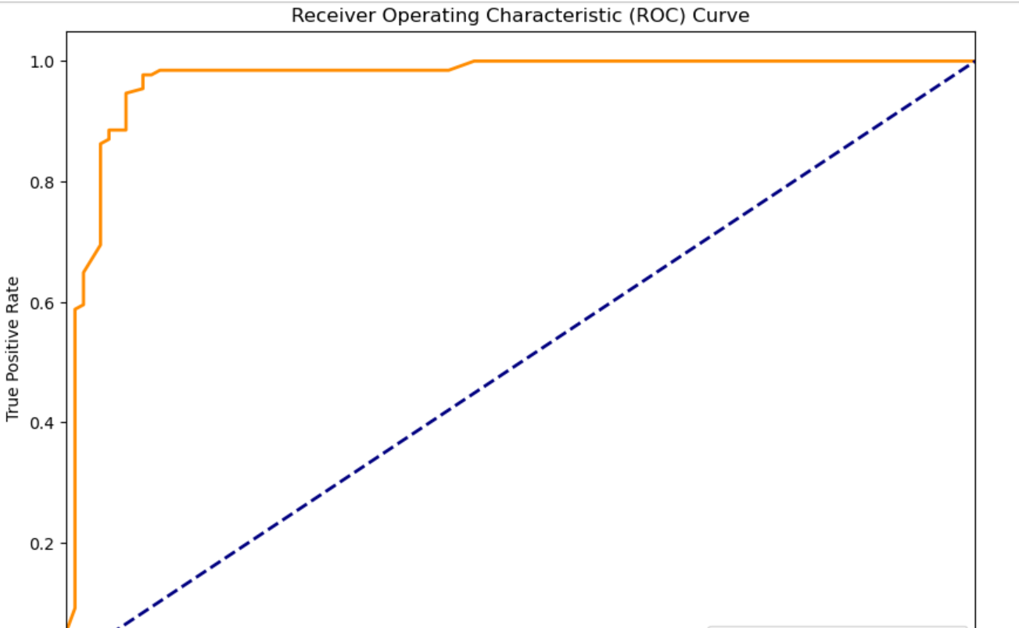
ROC Curve Analysis and AUC Comparison: Logistic Regression vs. Random Forest

Slide 9

Why Random Forest Performs Well
Complex Patterns: Random Forest excels at capturing complex, non-linear relationships and interactions between features, which often enhances predictive accuracy.
Robustness: The ensemble method averages multiple decision trees, reducing the risk of overfitting and improving generalization to new data.
Feature Handling: It effectively handles a mix of feature types and is less sensitive to noisy data compared to simpler models.
Summary: Random Forest's superior performance is due to its ability to model intricate patterns and its robustness against overfitting, making it highly effective for predicting heart disease.

Slide 10

Summary of Findings: Model Performance: Logistic Regression: Achieved high accuracy (87%) with good precision and recall, especially in predicting heart disease. Random Forest: Outperformed with an accuracy of 95% and higher AUC (0.97), demonstrating superior ability to distinguish between classes Key Insights: Accuracy: Both models performed well, but Random Forest showed a notable edge in accuracy and robustness. Complex Patterns: Random Forest's ability to handle complex interactions and reduce overfitting led to improved performance.

